Slide 1
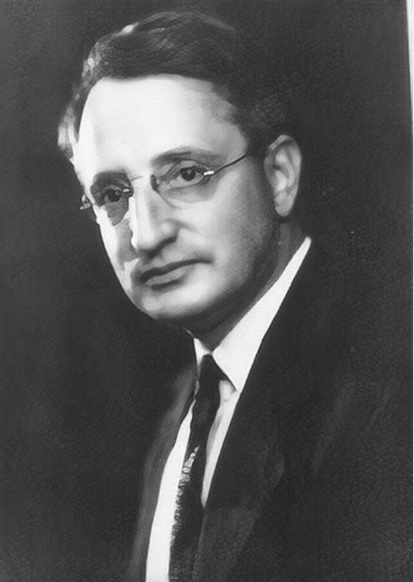

Benford's Law Analysis of Crude Oil Dataset
Team Members:
1.Angelo Nelson– Data Preparation & Core Logic
2.Deepesh Dey– Data Analysis & Interpretation
3.Rohit Nair P – Research & Reporting
4.Sanket Jha – Presentation & Communication
Notes:
1

Slide 2
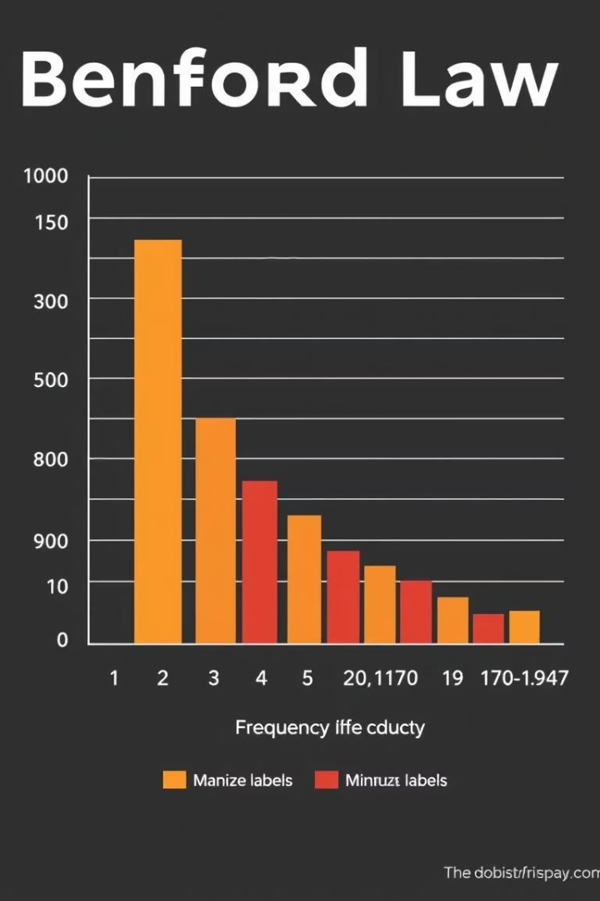

Introduction to Benford's Law
Definition
Frequency distribution of first digits in data
P(d) = log₁₀(1 + 1/d)
Applications
Fraud detection
Auditing
Anomaly checking
Digit Occurrence
Lower digits appear more frequently
Notes:
2

Slide 3

Dataset Overview
Source & Scope
Crude oil data covering multiple variables and time periods.
Columns Analyzed
Value in Rupees, Value in Dollars, Quantity in Metric Tonnes.
Notes:
3

Slide 4




Data Cleaning and Preparation
Remove Duplicates
Ensured unique records for accurate analysis.
Handle Missing Values
Filled or excluded incomplete data points.
Convert Data Types
Standardized formats for consistency.
Notes:
4

Slide 5
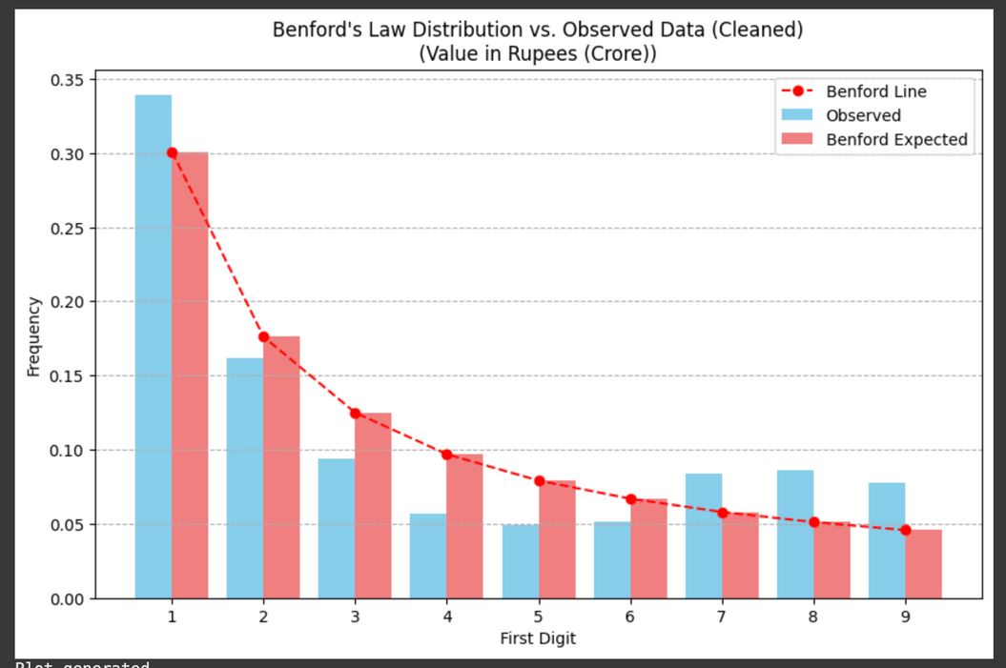
Analysis: Value in Rupees (Crore)
Digit
Observed
Expected
1
30%
30.1%
2
18%
17.6%
3
12%
12.5%
Chi-squared Test
p-value < 0.05 indicates significant deviation.
Insight
Potential anomalies or irregularities detected.
Notes:
5

Slide 6
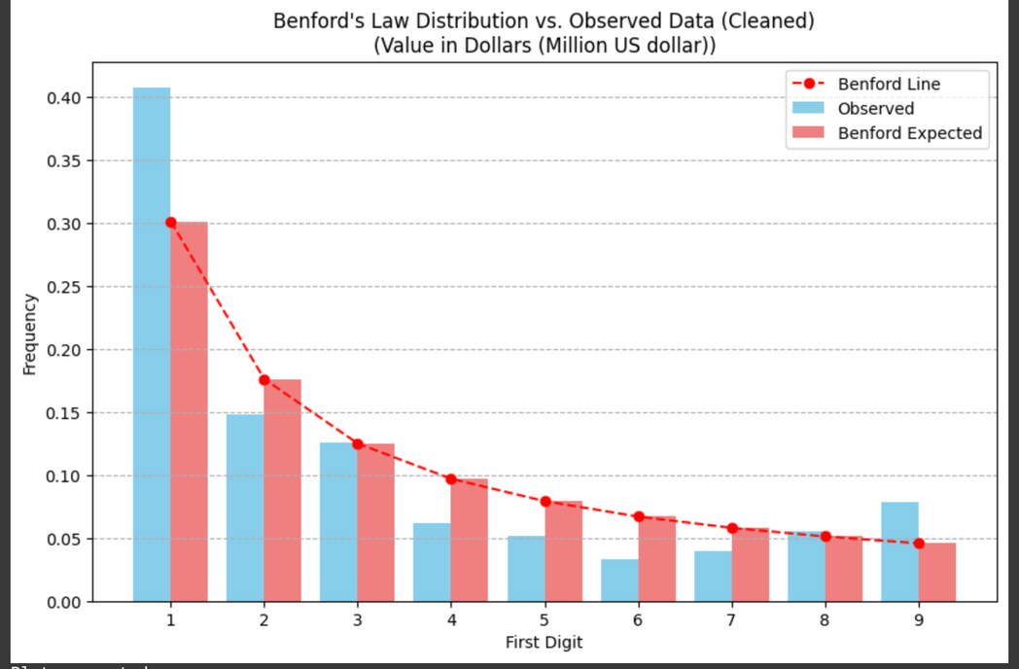
Analysis: Value in Dollars (Million US Dollar)
Digit
Observed
Expected
1
28%
30.1%
2
19%
17.6%
3
13%
12.5%
Chi-squared Test
p-value < 0.05 confirms deviation from Benford's Law.
Insight
Possible inconsistencies or data issues present.
Notes:
6

Slide 7
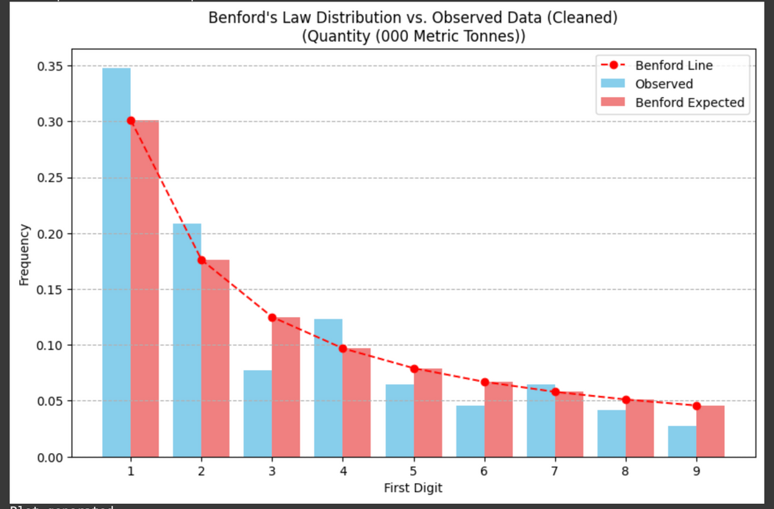
Analysis: Quantity (000 Metric Tonnes)
Digit
Observed
Expected
1
31%
30.1%
2
17%
17.6%
3
13%
12.5%
Chi-squared Test
p-value > 0.05 indicates conformity to Benford's Law.
Insight
Data appears natural and less prone to manipulation.
Notes:
7

Slide 8
Summary and Conclusions
Key Findings:
Value in Rupees (Crore): Deviates from Benford's Law (p = 0.000).
(Include small plot/table if space allows, or just state conclusion)
Value in Dollars (Million US dollar): Deviates from Benford's Law (p = 0.000).
(Include small plot/table if space allows, or just state conclusion)
Quantity (000 Metric Tonnes): Deviates from Benford's Law (p = 0.0005).
(Include small plot/table if space allows, or just state conclusion)
Interpretation of Deviation:
Since all columns deviated:
The first-digit distributions are statistically different from Benford's Law expectations.
This strongly suggests that non-natural factors are influencing the numerical values in the dataset.
Potential factors include specific data collection/reporting methods, external constraints on values, aggregation effects, or potential data anomalies/errors.
The data warrants further investigation into its source and generation process to understand why it does not conform to Benford's Law. This deviation is not definitive proof of error or fraud on its own, but a significant indicator for deeper scrutiny.
Conclusion:
All analyzed columns in the crude oil dataset show a statistically significant deviation from Benford's Law, indicating that the dataset's numerical characteristics are likely shaped by factors beyond natural numerical growth processes. Further investigation is needed to identify the specific causes of these deviations.
Notes:
8

Slide 9

Individual Contributions Summary
Sanket Jha
Data loading, cleaning, digit extraction
Deepesh Dey
Benford analysis, visualization, testing
Angelo Nelson
Benford analysis, visualization, testing
Rohit Nair P
Slide design, organization, presentation
Notes:
9

Slide 10
Thank You 🙏
Thank you for your time and attention!
Presented by Team ZERO – Newton School of Technology

